Slide 1


Online Beauty Parlour Appointment System
Welcome to the future of beauty appointments! Our innovative online booking platform streamlines the process of scheduling services at your favorite beauty parlours. Whether you're seeking a relaxing massage, a vibrant new hair colour, or a flawless makeup application, our platform provides a convenient and user-friendly experience.
SAI BHAVANI.G(192211319)
GAYATRI.C(192211267)
ABINAYA.K(192211931)
PUNITHA.S(192211579)
RAMYA.T(192210450)

Slide 2
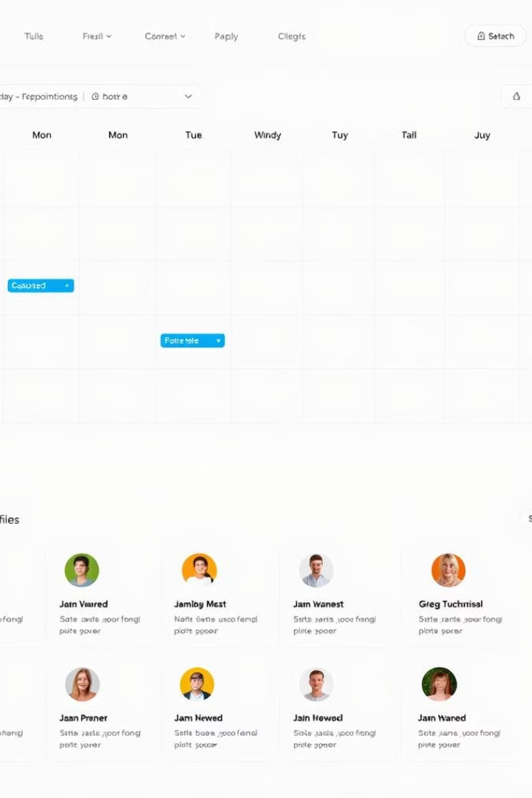
Introduction to Online Booking Platform
Effortless Scheduling
Seamless Experience
Our platform allows you to book appointments directly online, eliminating the need for phone calls or email exchanges. Simply browse available times, select your desired services, and confirm your booking in a few simple steps.
Our intuitive interface and clear navigation make booking appointments a breeze. You can easily view available time slots, select multiple services, and manage your appointments all in one place.
Time Saving
Our platform saves you valuable time by automating the appointment process. No more waiting on hold or sending multiple emails. You can book your appointments anytime, anywhere, with just a few clicks.

Slide 3
Features of the Appointment System
1
Diverse Service Options
2
Real-time Availability
Our system accommodates a wide range of beauty services, from hair care and makeup to skin treatments and waxing. You can easily find the specific services you need, ensuring a complete and personalized experience.
Our system updates in real time, providing accurate information on available time slots. You can avoid wasted time and ensure that your appointment is scheduled with the right stylist or technician.
3
Detailed Service Descriptions
4
Secure Information Storage
Each service includes a detailed description, outlining the procedures involved and the expected outcome. This allows you to make informed decisions about your appointments and choose the best option for your needs.
We prioritize your privacy and security. All your personal and appointment information is stored securely, ensuring that your data is protected from unauthorized access.

Slide 4
Seamless User Experience
Intuitive Navigation
Mobile-Responsive Design
24/7 Accessibility
Our platform is designed with user-friendliness in mind. The clear navigation, intuitive menus, and straightforward search options make it easy to find the information you need and complete your booking quickly and efficiently.
Our platform is optimized for all devices, including smartphones and tablets. You can easily access and manage your appointments from anywhere, anytime, ensuring a seamless experience.
Our booking platform is available 24/7, allowing you to schedule appointments at your convenience. No more waiting for business hours or struggling to reach someone by phone. You can book appointments anytime, day or night.

Slide 5
Customizable Booking Options
Service Selection
1
Choose from a wide array of beauty services, from haircuts and styling to facials, manicures, and waxing. Our system allows you to select multiple services for a complete beauty experience.
2
Date and Time Flexibility
Browse available time slots that suit your schedule. Our system offers a range of appointment options, allowing you to book services for a specific date and time.
Stylist Preferences
3
If you have a preferred stylist, you can easily select them during the booking process. Our platform ensures that you're matched with your favorite technician for a personalized experience.
4
Additional Requests
Add any specific requests or preferences, such as a desired haircut style, preferred products, or allergy information. This allows you to communicate your needs clearly and ensure a satisfying experience.

Slide 6
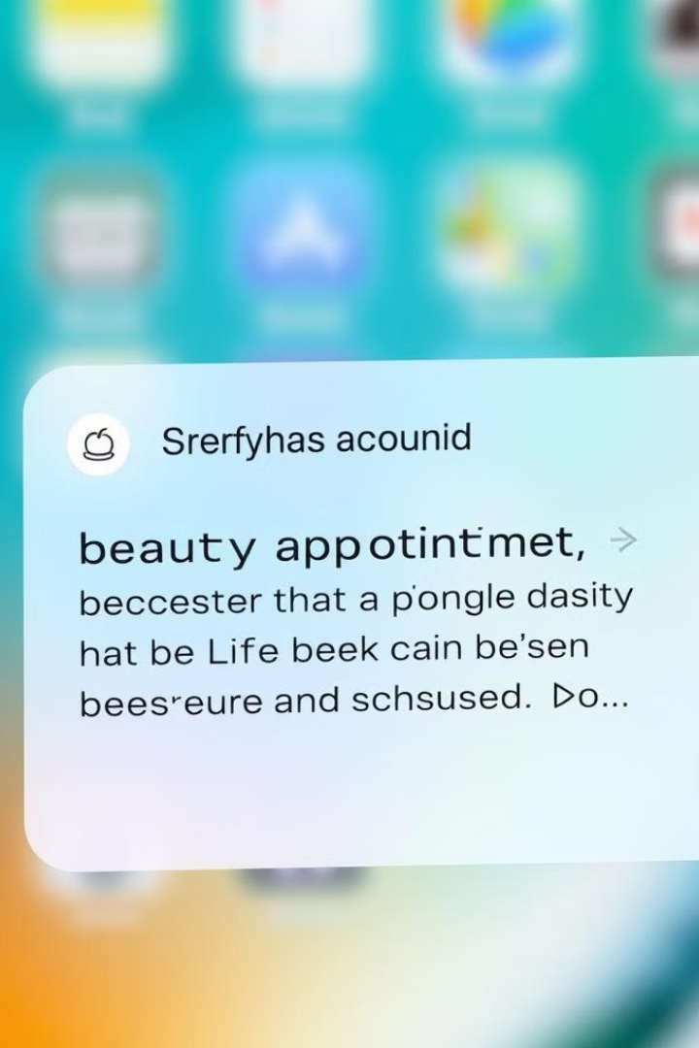
Automated Reminders and Notifications
Reminders
Our system sends automated appointment reminders to both customers and salon staff, ensuring that everyone is informed and prepared for upcoming appointments.
Notifications
Receive real-time notifications about appointment changes, cancellations, or confirmations, ensuring that you're always up-to-date and in control of your schedule.
Reduced No-Shows
Automated reminders help to minimize no-shows, reducing wasted time and resources for both customers and salons.

Slide 7
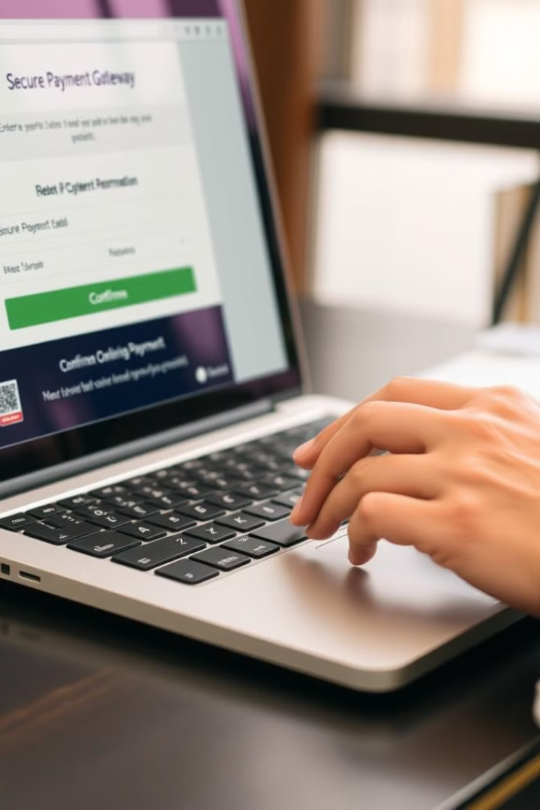



Payment Processing
Multiple Payment Options
Our system supports a variety of popular payment methods, including credit cards, debit cards, and digital wallets, making it convenient for customers to pay for their appointments.
Secure Transactions
All payment information is processed through a secure, encrypted gateway, protecting your data and ensuring secure financial transactions.
Automated Receipts
Customers receive digital receipts after completing their payments, providing a record of their transactions and simplifying expense tracking.

Slide 8
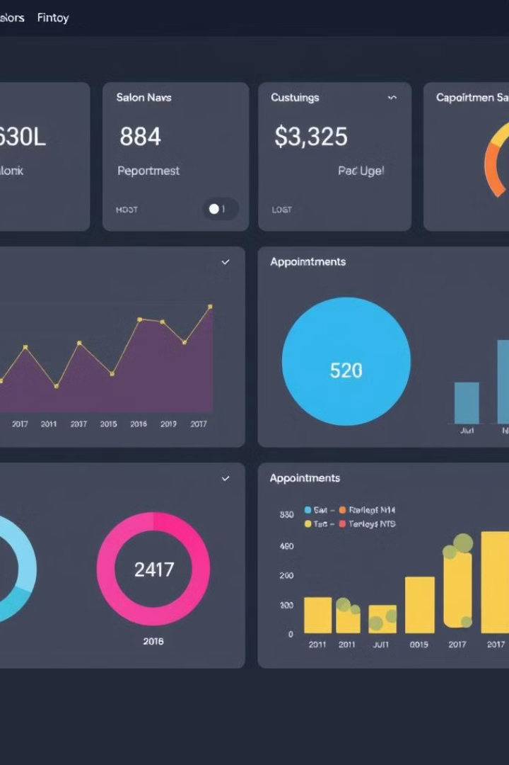
Analytics and Reporting
1
Appointment
2
Customer Insights
Track customer demographics, booking history, and feedback to identify key customer segments and personalize your services to meet their needs.
Gain valuable insights into booking patterns, popular services, and peak hours to better understand customer demand and optimize your scheduling.
3
Performance Analysis
Monitor key metrics such as appointment completion rates, cancellation rates, and customer satisfaction scores to evaluate your business performance and identify areas for improvement.

Slide 9
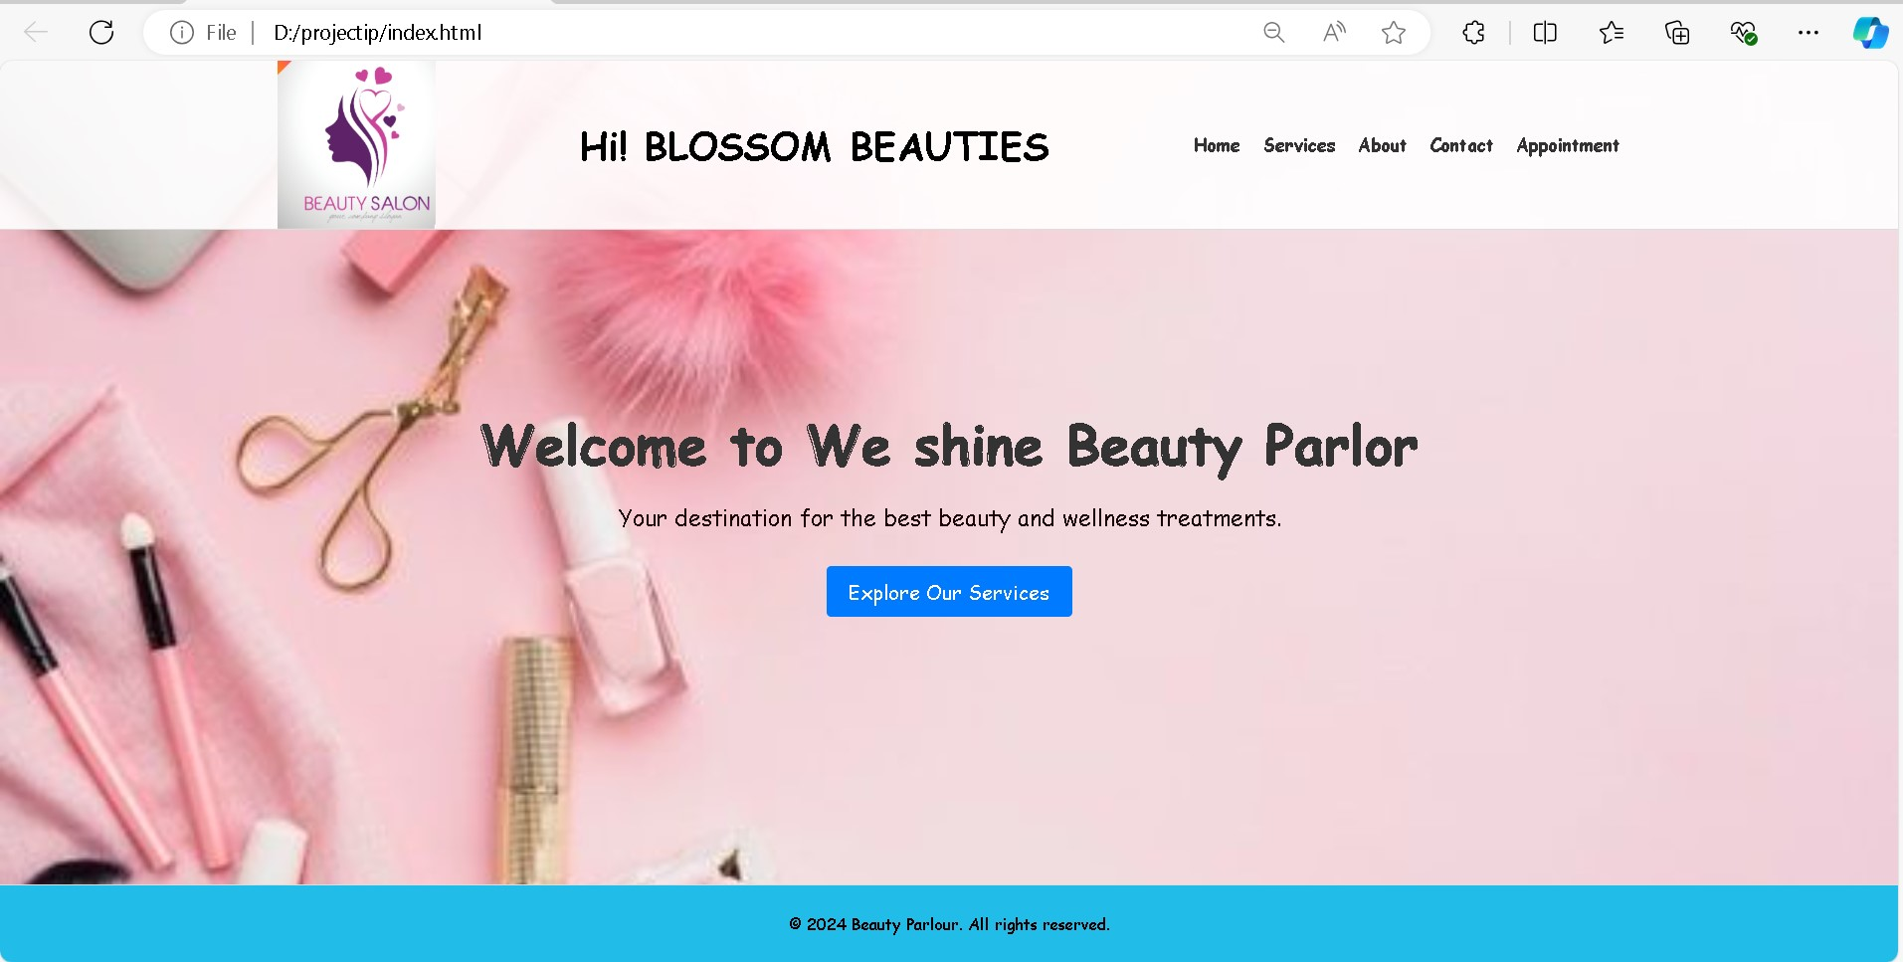
OUTPUT

Slide 10
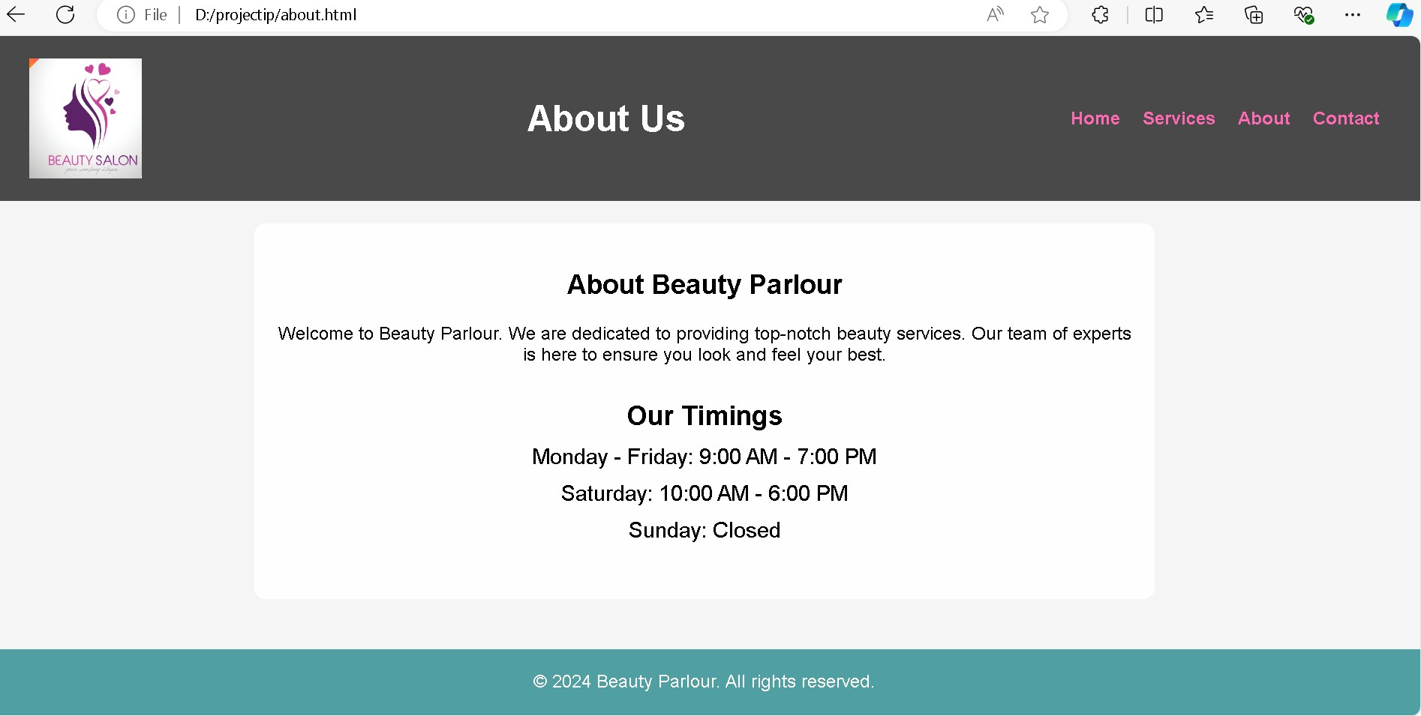

Slide 11
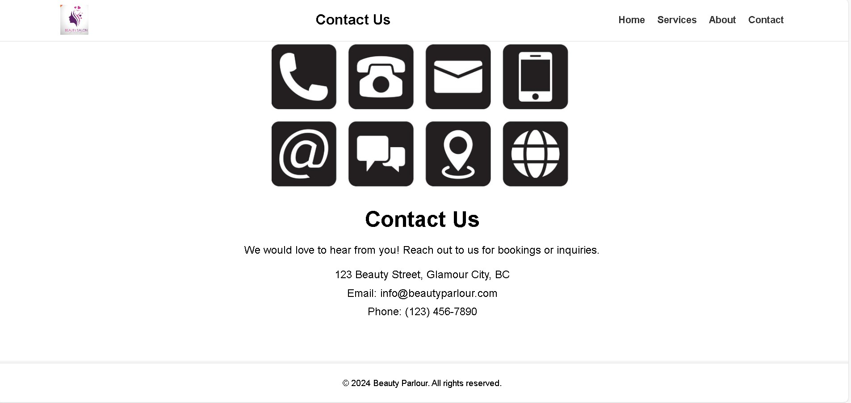

Slide 12
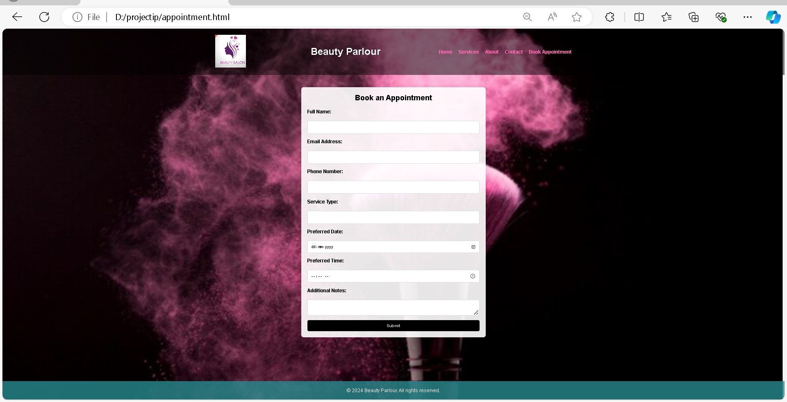

Slide 13
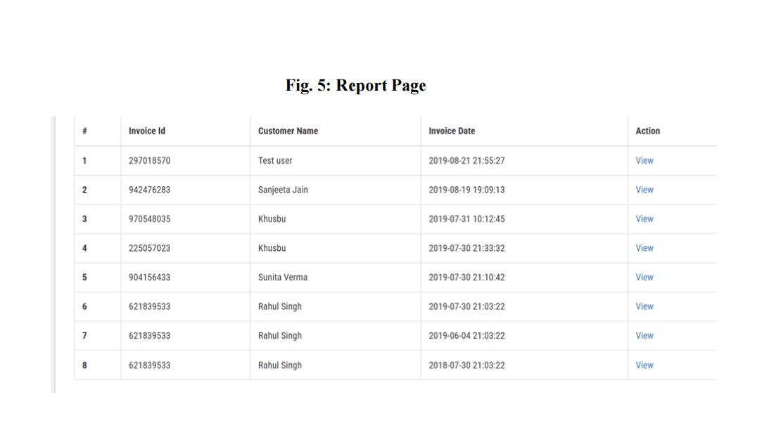

Slide 14

Conclusion
Our online beauty parlour appointment system offers a comprehensive solution for streamlining bookings and enhancing the customer experience. We encourage you to explore our platform, discover its features, and experience the convenience and efficiency it brings to your business.
Ready to take your business to the next level? Contact us today to schedule a personalized demo and learn more about how our platform can help you attract new customers, manage your appointments effectively, and create a truly exceptional beauty experience for your clients.

Slide 15


